Slide 1
A Survey of Neural Surface Reconstruction
Ruoxi Li
05/03/2024

Slide 2
Outline
Introduction
Neural Surface Reconstruction
NeRF, NeuS, VolSDF
Geometry Constrains: MonoSDF, Geo-Neus
Coarse to fine: NeuS2, Neuralangelo
Efficient Sampling: PermutoSDF, Sphere-Guided Training of Neural Implicit Surfaces
Takeaways

Slide 3
Introduction
Reconstructing surfaces from multi-view images is a fundamental problem in computer vision and computer graphics.
3D reconstruction with neural implicit representations has recently become a highly promising alternative to classical reconstruction approaches due to its high reconstruction quality and its potential to reconstruct complex objects that are difficult for classical approaches.
Notes:
We want to built 3D model based on limitation number input images.

Slide 4
Agenda
Introduction
Neural Surface Reconstruction
NeRF, NeuS, VolSDF (Main Methods)
Geometry Constrains: MonoSDF, Geo-Neus
Coarse to fine: NeuS2, Neuralangelo
Efficient Sampling: PermutoSDF, Sphere-Guided Training of Neural Implicit Surfaces
Takeaways

Slide 5
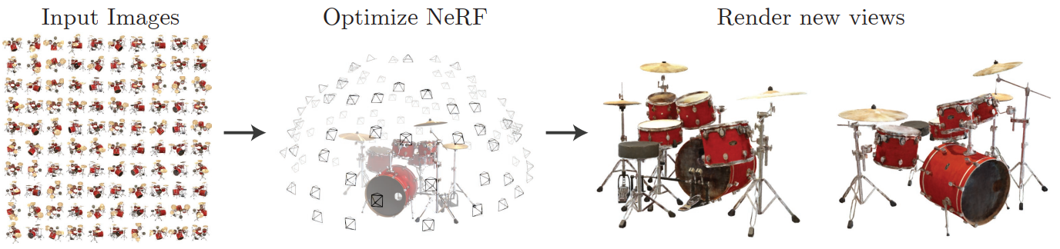
NeRF: Representing Scenes as Neural Radiance Fields for View Synthesis
Synthesize novel views of complex scenes by optimizing an underlying continuous volumetric scene function using a sparse set of input views.
Notes:
This is the first paper in this area, and following papers all based on this theory . But strictly , this is not a surface reconstruction method.
Learn the radiance field, then we can get the new view based on this fileld.

Slide 6
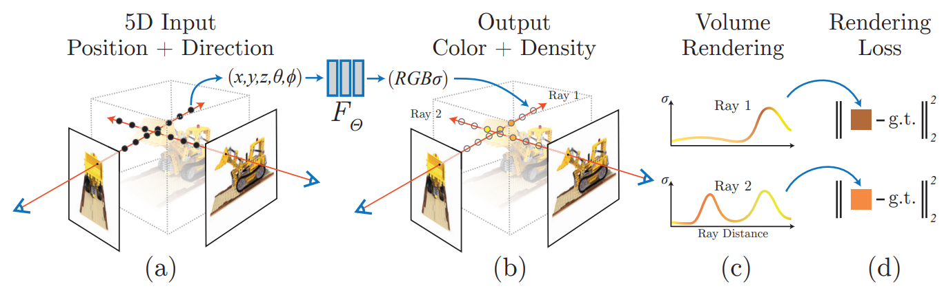
NeRF: Representing Scenes as Neural Radiance Fields for View Synthesis
Represent a static scene as a continuous 5D function that outputs the radiance emitted in each direction (θ; φ) at each point (x; y; z) in space.
Optimize a MLP to represent this function by regressing from a single 5D coordinate (x; y; z; θ; φ) to a single volume density and view-dependent RGB color.
Notes:
What is the radiance field? The RGBsigma.
Multi-layer perceptron.

Slide 7
NeRF: Representing Scenes as Neural Radiance Fields for View Synthesis
Volume rendering:
Notes:
We need to train the neural network. The strategy is calculating the difference between the rendered image and ground truth image. R(t) is the ray. From different angel, we can get various loss, the we normalize and summarize all of them.

Slide 8
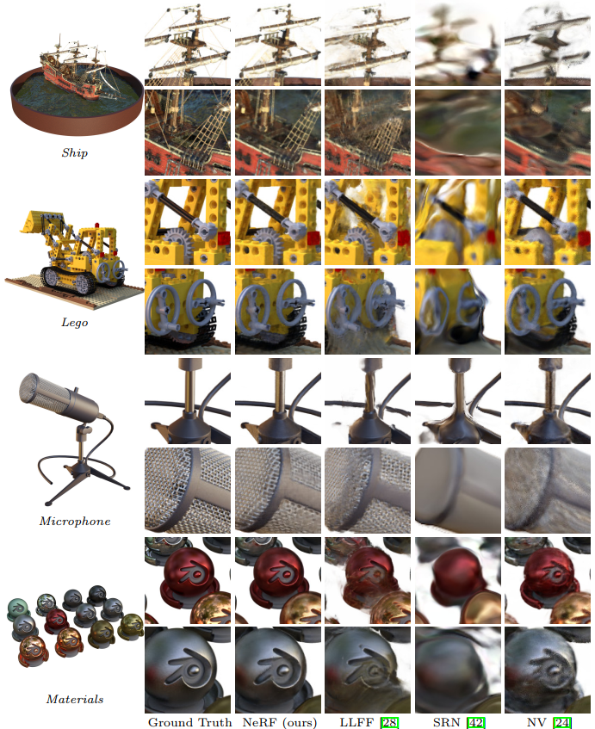
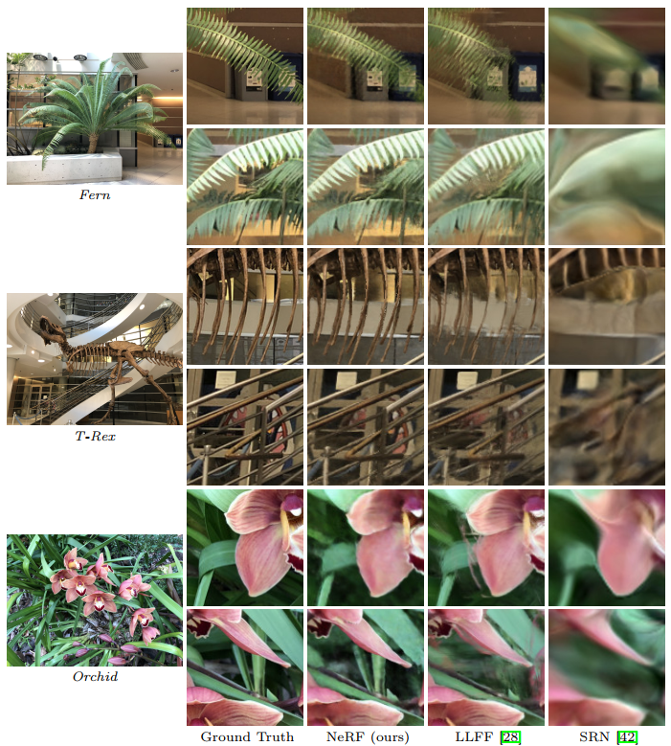
NeRF: Representing Scenes as Neural Radiance Fields for View Synthesis
Notes:
NeRF has the closest result to ground truth.

Slide 9
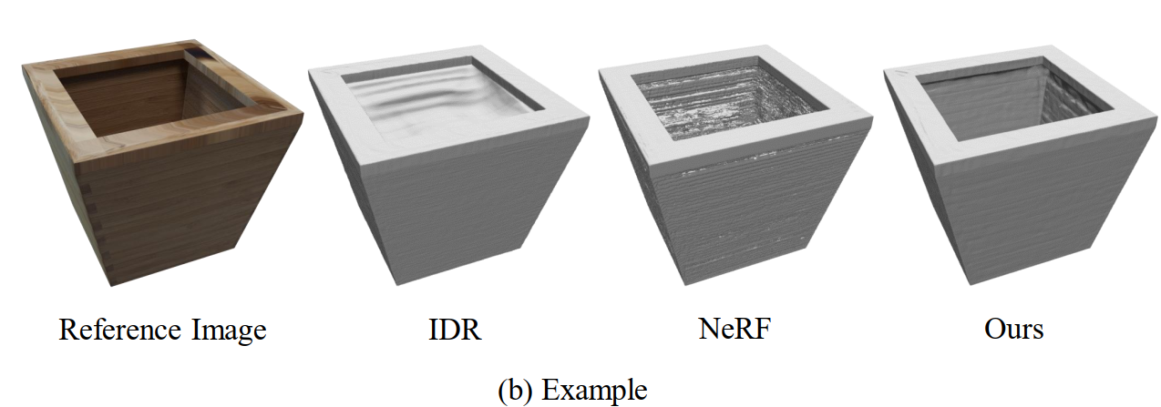
NeuS: Learning Neural Implicit Surfaces by Volume Rendering for Multi-view Reconstruction
NeRF is intended for novel view synthesis rather than surface reconstruction, it only learns a volume density field, from which it is difficult to extract a high-quality surface.
Need to add prior information about the surface to the model.

Slide 10
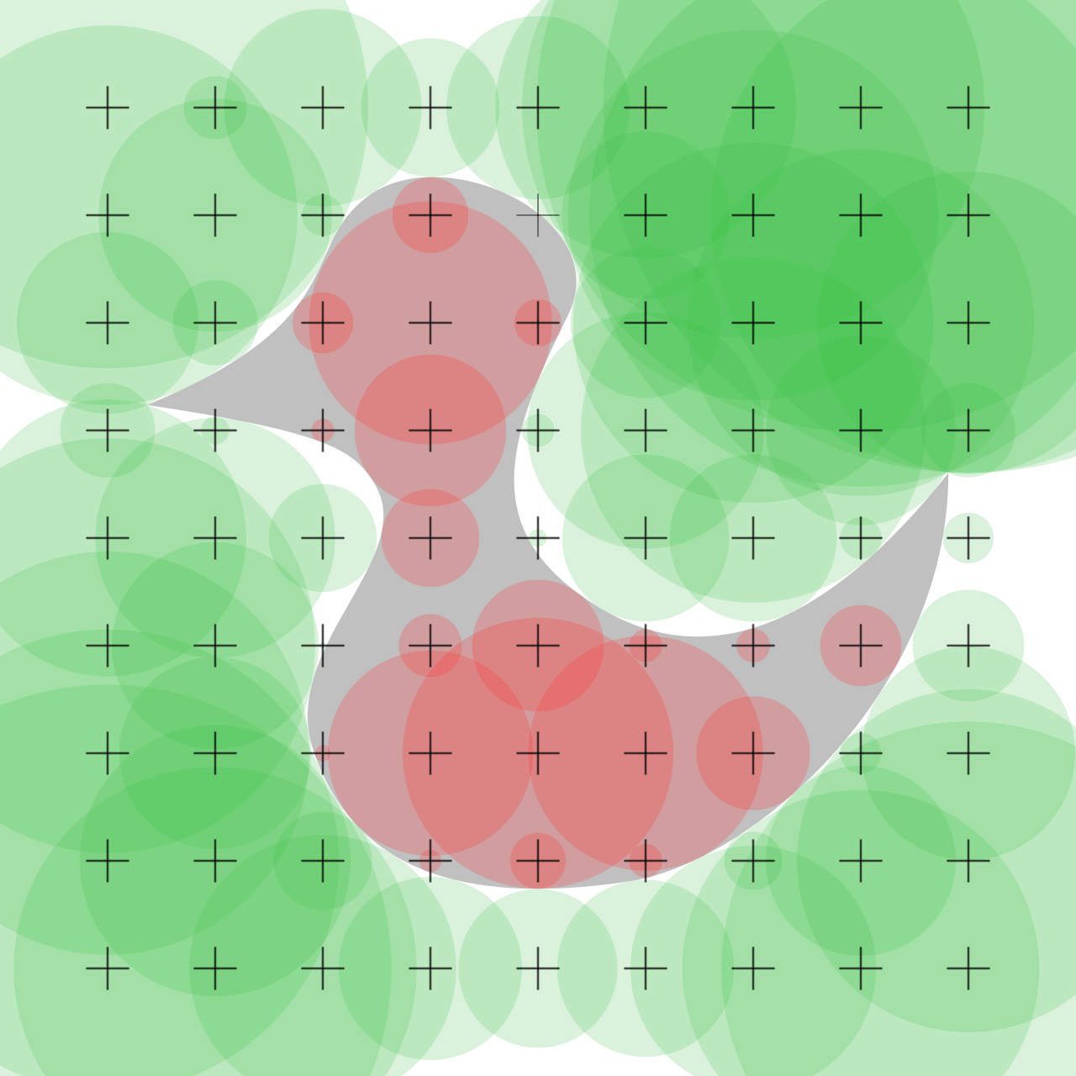
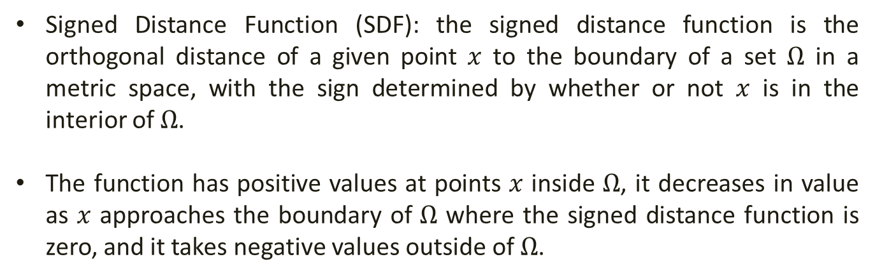
NeuS: Learning Neural Implicit Surfaces by Volume Rendering for Multi-view Reconstruction
Signed Distance Function (SDF): the signed distance function is the orthogonal distance of a given point $x$ to the boundary of a set $Ω$ in a metric space, with the sign determined by whether or not $x$ is in the interior of $Ω$.
The function has positive values at points $x$ inside $Ω$, it decreases in value as $x$ approaches the boundary of $Ω$ where the signed distance function is zero, and it takes negative values outside of $Ω$.

Slide 11
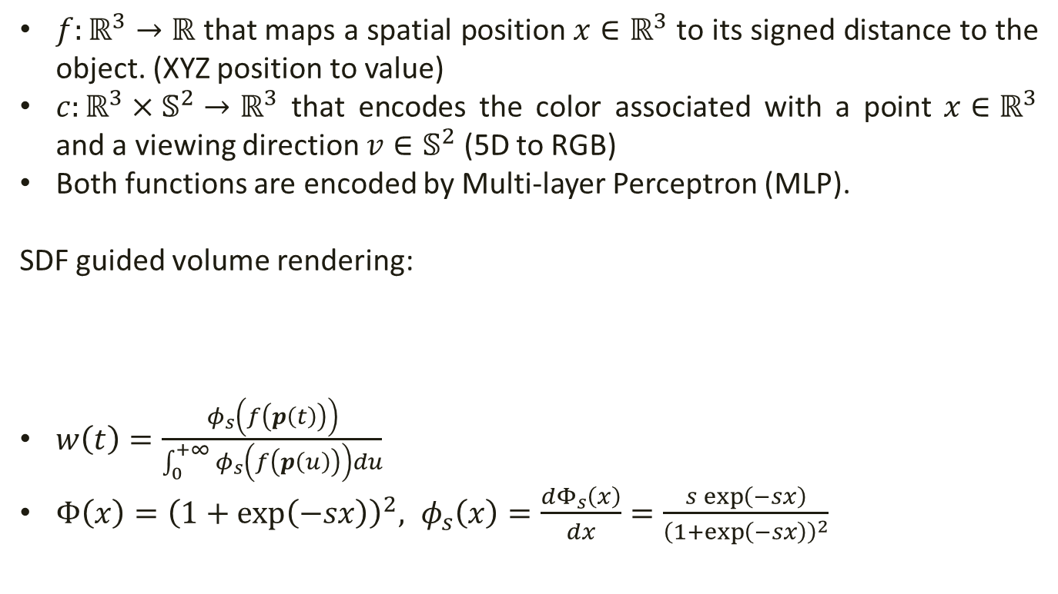
NeuS: Learning Neural Implicit Surfaces by Volume Rendering for Multi-view Reconstruction
$f:ℝ^{3}→ℝ$ that maps a spatial position $x∈ℝ^{3}$ to its signed distance to the object. (XYZ position to value)
$c:ℝ^{3}×𝕊^{2}→ℝ^{3}$ that encodes the color associated with a point $x∈ℝ^{3}$ and a viewing direction $v∈𝕊^{2}$ (5D to RGB)
Both functions are encoded by Multi-layer Perceptron (MLP).
SDF guided volume rendering:
$w\left(t\right)=\frac{φ_{s}\left(f\left(p\left(t\right)\right)\right)}{\int_{0}^{+∞}{φ_{s}\left(f\left(p\left(u\right)\right)\right)du}}$
$Φ\left(x\right)={\left(1+\exp\left(−sx\right)\right)}^{2}, φ_{s}\left(x\right)=\frac{dΦ_{s}\left(x\right)}{dx}=\frac{s\exp\left(−sx\right)}{{\left(1+\exp\left(−sx\right)\right)}^{2}}$
Notes:
Key is the volume rendering. We still want to use volume rendering to get 2D image for training.

Slide 12
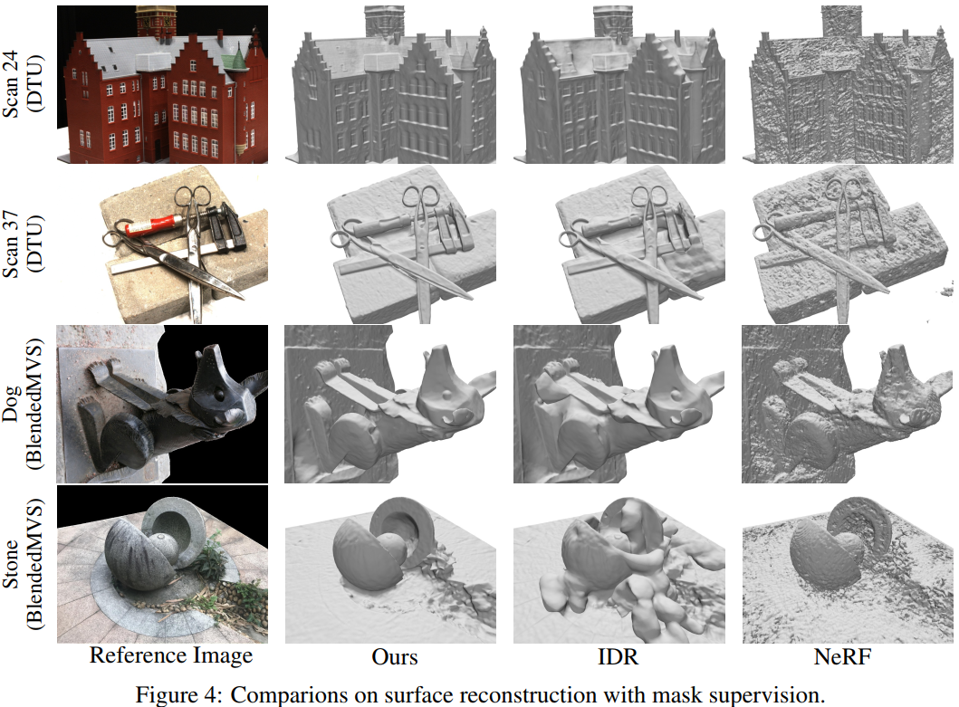
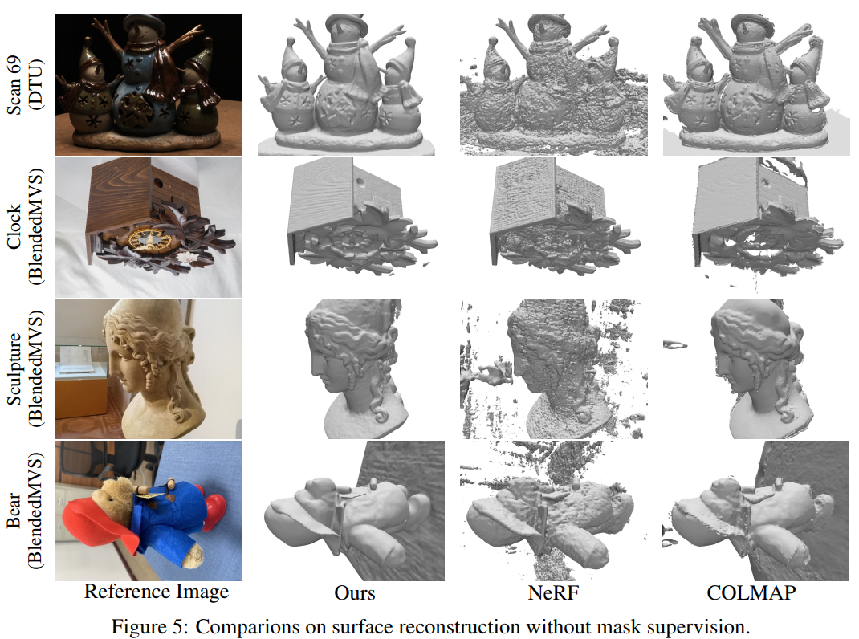
NeuS: Learning Neural Implicit Surfaces by Volume Rendering for Multi-view Reconstruction

Slide 13
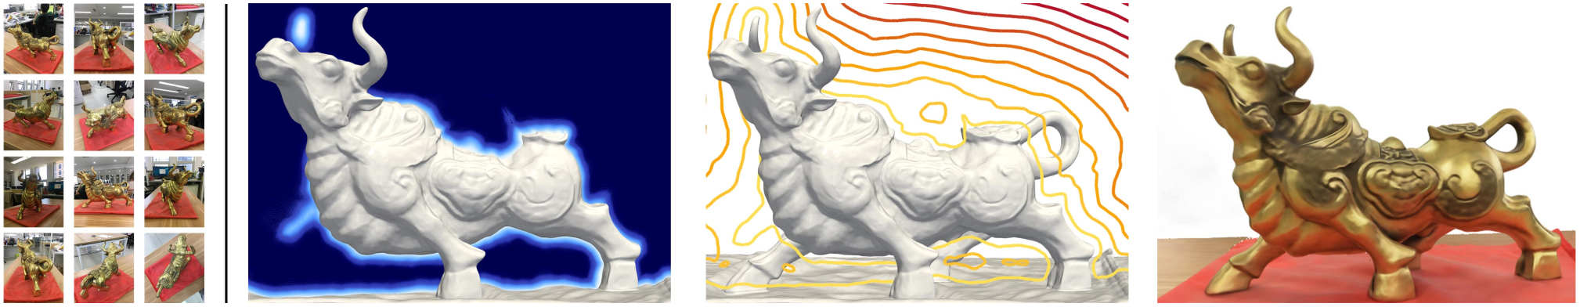
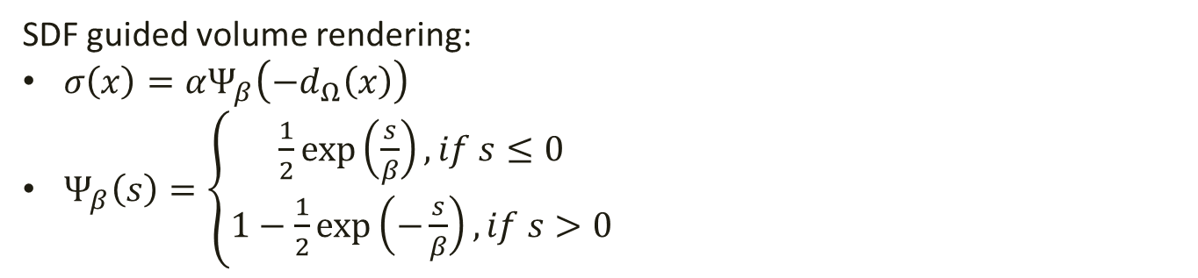
VolSDF: Volume Rendering of Neural Implicit Surfaces
SDF guided volume rendering:
$σ\left(x\right)=αΨ_{β}\left(−d_{Ω}\left(x\right)\right)$
$Ψ_{β}\left(s\right)=\left\{\begin{aligned}\frac{1}{2}\exp\left(\frac{s}{β}\right), if s≤0 \\ 1−\frac{1}{2}\exp\left(−\frac{s}{β}\right),if s>0\end{aligned}\right.$
Notes:
D omega is the signed distance function .

Slide 14
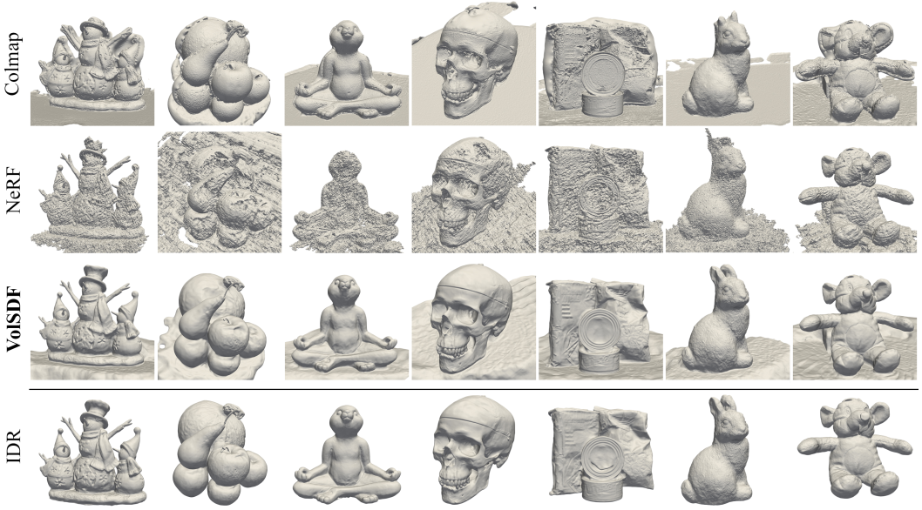
VolSDF: Volume Rendering of Neural Implicit Surfaces

Slide 15
Agenda
Introduction
Neural Surface Reconstruction
NeRF, NeuS, VolSDF
Geometry Constrains: MonoSDF, Geo-Neus
Coarse to fine: NeuS2, Neuralangelo
Efficient Sampling: PermutoSDF, Sphere-Guided Training of Neural Implicit Surfaces
Takeaways

Slide 16
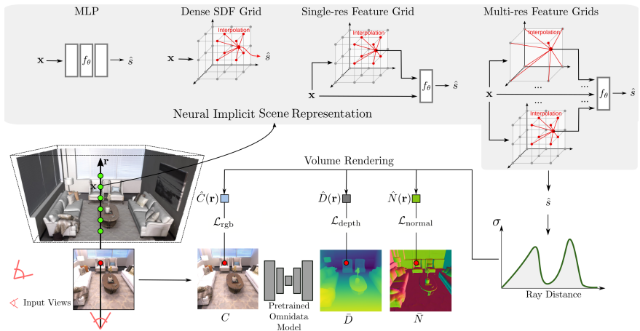
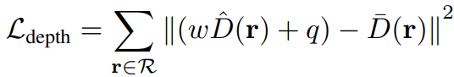
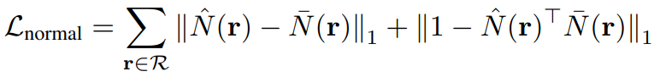
MonoSDF: Exploring Monocular Geometric Cues for Neural Implicit Surface Reconstruction
Notes:
They add some losses for training to get better result. On is the depth and another is normal vector of the surface. Compare the predict depth and normal vector to the ground truth to get the loss. Hat is predicted and bar is ground truth. Normal: first part is value and second is the angel diff.
MLP: multi layer perceptron

Slide 17
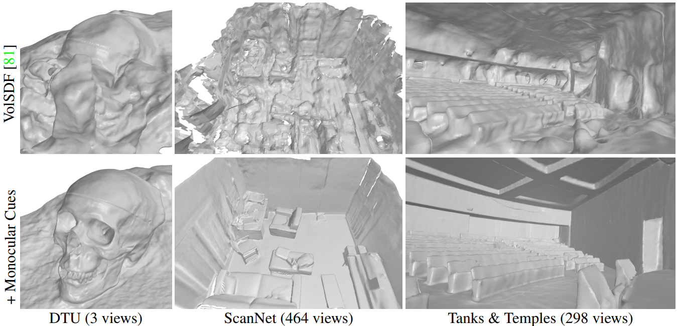
MonoSDF: Exploring Monocular Geometric Cues for Neural Implicit Surface Reconstruction
Reconstruction quality highly depend on the accuracy of depth map and normal map

Slide 18
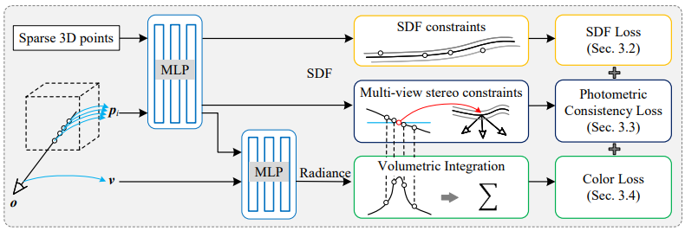
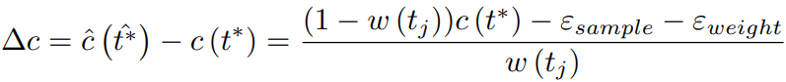
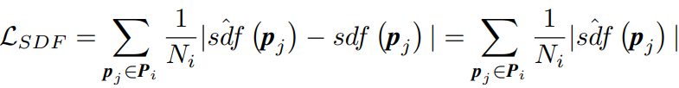
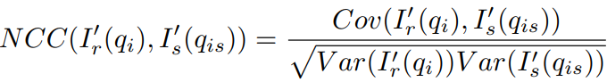
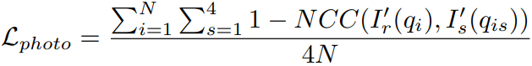
Geo-Neus: Geometry-Consistent Neural Implicit Surfaces Learning for Multi-view Reconstruction
NCC: normalization cross correlation which reflect the correlation between different figures
Notes:
NCC: normalization cross correlation
This method solve the disadvantage from the MoNoSDF
Picked pixel may not exactly on the surface may include the sdf loss, weight(photo metric loss) is the error due to the volume process.

Slide 19
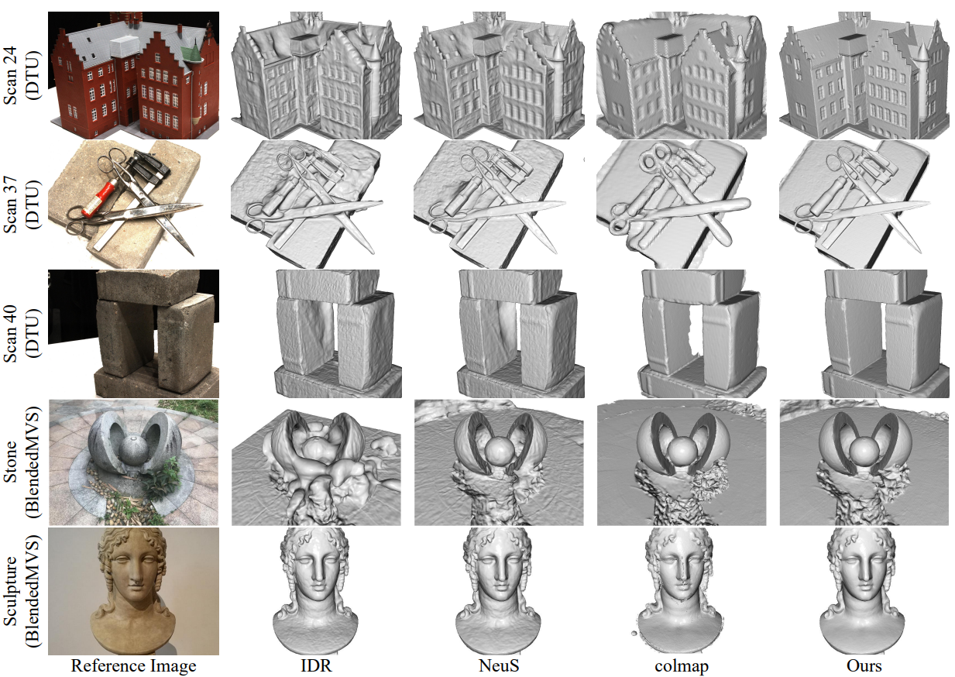
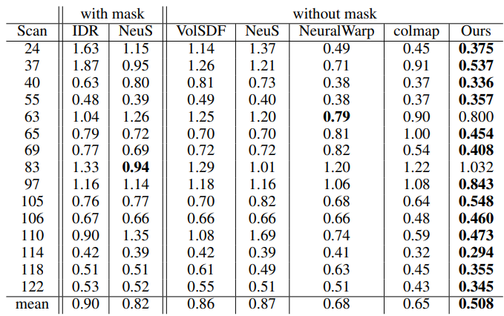
Geo-Neus: Geometry-Consistent Neural Implicit Surfaces Learning for Multi-view Reconstruction

Slide 20
Agenda
Introduction
Neural Surface Reconstruction
NeRF, NeuS, VolSDF
Geometry Constrains: MonoSDF, Geo-Neus
Coarse to fine: NeuS2, Neuralangelo (Speed Up Training Process)
Efficient Sampling: PermutoSDF, Sphere-Guided Training of Neural Implicit Surfaces
Takeaways

Slide 21
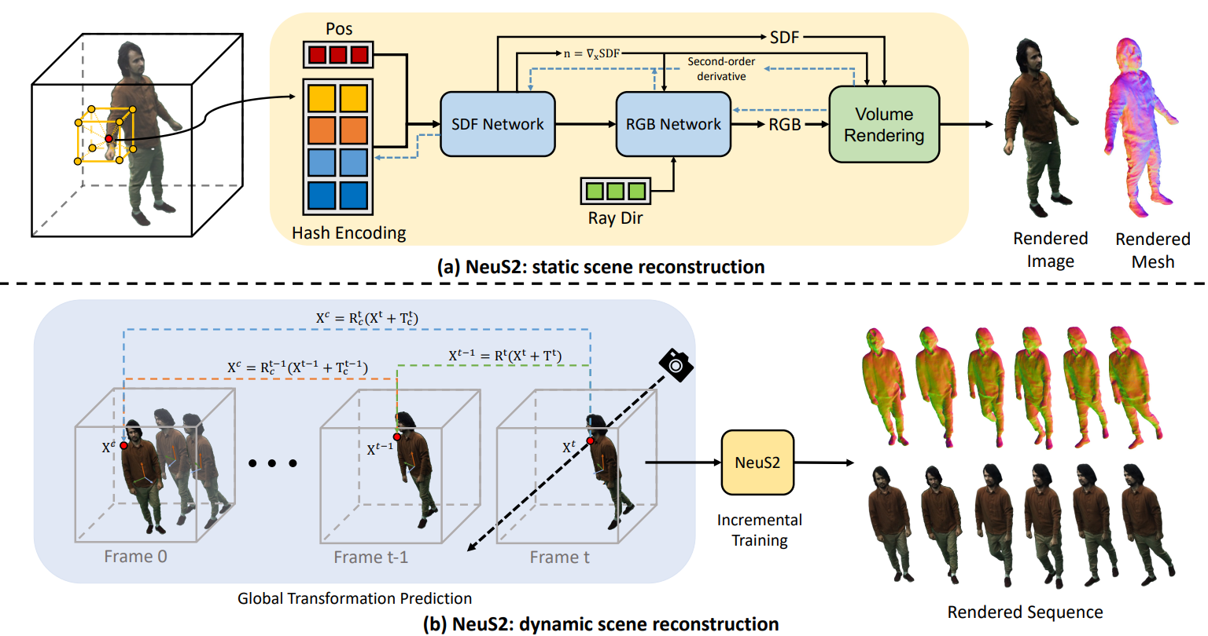
NeuS2: Fast Learning of Neural Implicit Surfaces for Multi-view Reconstruction
Notes:
Separate to lots of grid. Use hash function to map the grid to smaller space. Like 100k grids has been encoding to 5k grides. But afer shrinking, the may have the hash Collison. But it is not influence much since surface grid only occupied small part.
Do training on sparse grids, then do training on dense grid. This can speed up training process.

Slide 22
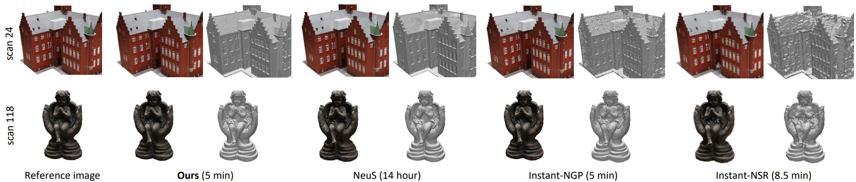
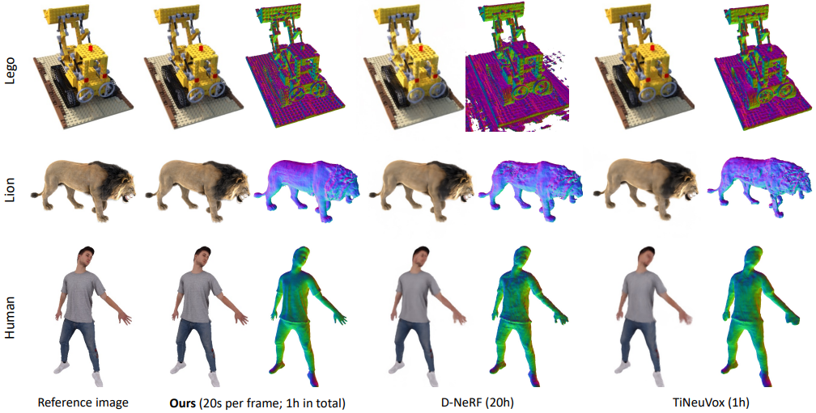
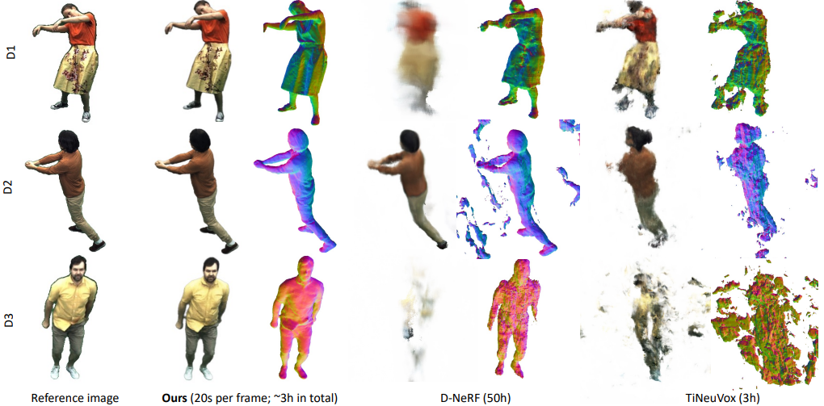
NeuS2: Fast Learning of Neural Implicit Surfaces for Multi-view Reconstruction

Slide 23
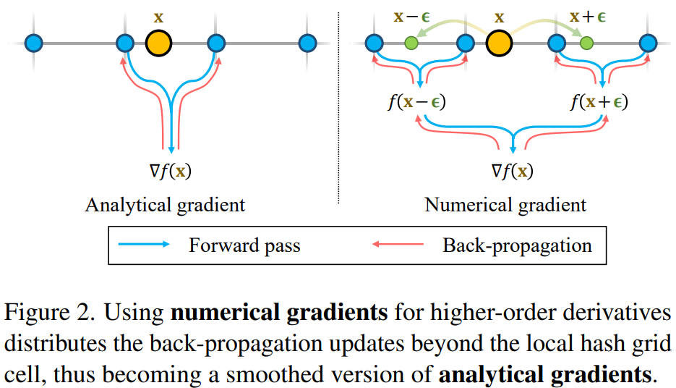
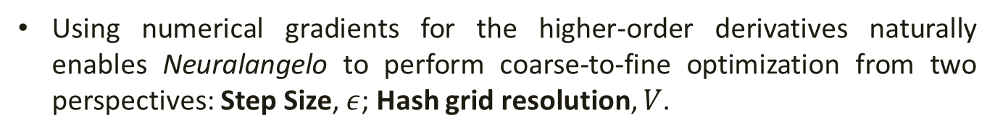
Neuralangelo: High-Fidelity Neural Surface Reconstruction
Using numerical gradients for the higher-order derivatives naturally enables Neuralangelo to perform coarse-to-fine optimization from two perspectives: Step Size, $ε$; Hash grid resolution, $V$.
Notes:
More neighboor points making the surface smoothy.

Slide 24
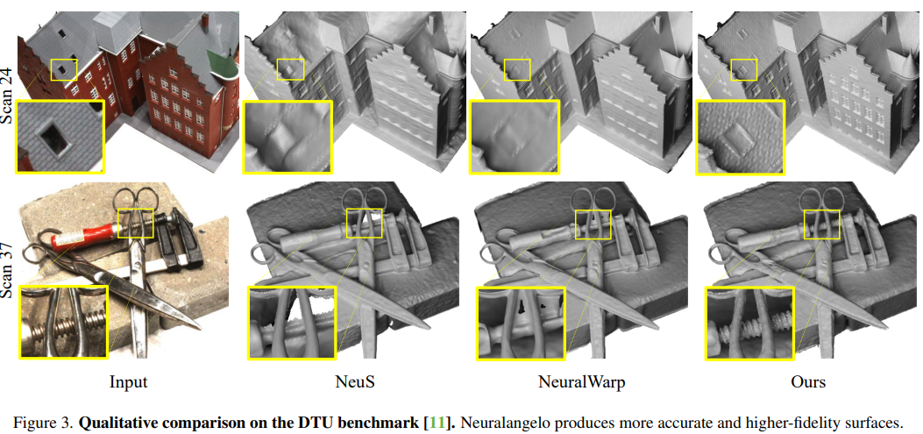
Neuralangelo: High-Fidelity Neural Surface Reconstruction

Slide 25
Agenda
Introduction
Neural Surface Reconstruction
NeRF, NeuS, VolSDF
Geometry Constrains: MonoSDF, Geo-Neus
Coarse to fine: NeuS2, Neuralangelo
Efficient Sampling: PermutoSDF, Sphere-Guided Training of Neural Implicit Surfaces
Takeaways

Slide 26
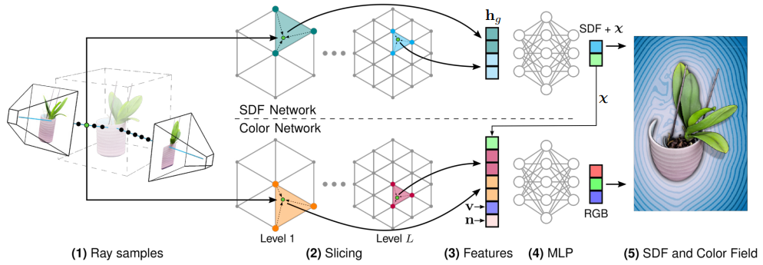
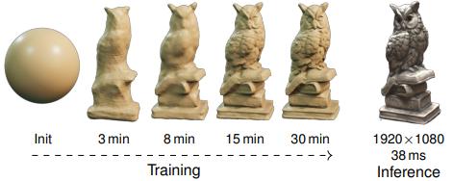
PermutoSDF: Fast Multi-View Reconstruction with Implicit Surfaces using Permutohedral Lattices
Notes:
Several optimization on the triangle grid. Cubic have 8 points, permutohedral only have 4. Speed up

Slide 27
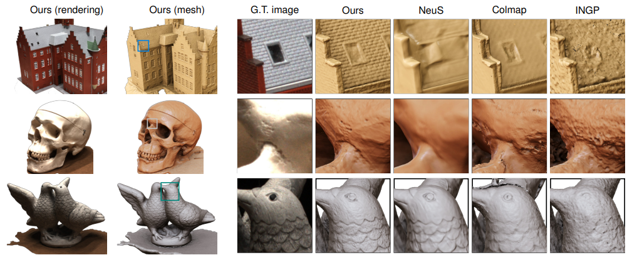
PermutoSDF: Fast Multi-View Reconstruction with Implicit Surfaces using Permutohedral Lattices
Notes:
Much more texture.

Slide 28
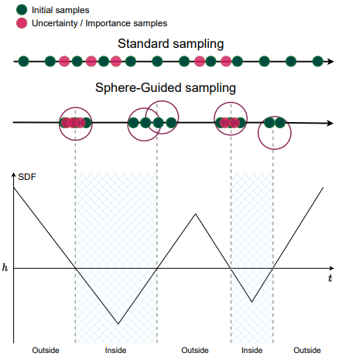
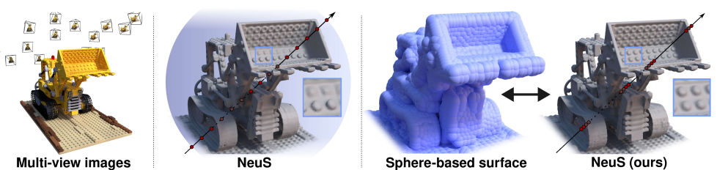
Sphere-Guided Training of Neural Implicit Surfaces

Slide 29
Takeaways
Reconstructing surfaces from multi-view images is a fundamental problem in computer vision and computer graphics.
Volume rendering based neural surface reconstruction have shown promising results.
Different strategies including, adding constrains, coarse-to-fine training and efficient sampling have been introduced to improve both surface reconstruction accuracy and training speed.

